Slide 1
Project Name: REVENUE GENERATION ANALYSIS ON E-COMMERCE WEBSITE by Student Name: Ayesha Nafis SAP ID: 70189383
Tools and Techniques

Slide 2
Project Introduction
To predict an e-commerce website generates revenue or not
Based on browsing behavior and session characteristics
Use machine learning algorithms for prediction
Target Variable
Revenue (True/False)

Slide 3
Project Objective
Analyze customer browsing behavior
Perform data preprocessing
Create new features using feature engineering
Train multiple machine learning models
Compare model performance
Select the best model for revenue prediction

Slide 4
Dataset Overview
Dataset:
E-Commerce Revenue Dataset
Total Records: 12,205
Original Features: 42
Target Variable: Revenue
Data Types
Numerical Features
Categorical Features
Binary Target Variable

Slide 5
Data Preprocessing
Performed Tasks
Missing Value Handling
Typo and spelling errors
Outlier Analysis
Encoding Categorical Features
Feature Scaling
Correlation Analysis
Benefits
Improved data quality
Reduced noise
Better model performance

Slide 6
Exploratory Data Analysis (EDA)
Visualizations Used
Revenue Distribution
Histograms
Box Plots
Correlation Heatmap
Visitor Type Analysis
Monthly Revenue Analysis
Key Insight
Revenue-generating customers are fewer than non-revenue customers.

Slide 7
Feature Engineering
Custom Features Created
Total_Time
Total_Pages
Engagement_Ratio
Value_Per_Page
Binning Features
ProductRelated_Duration_Bin
BounceRates_Bin
Advanced Features
Polynomial Features (Degree = 2)

Slide 8
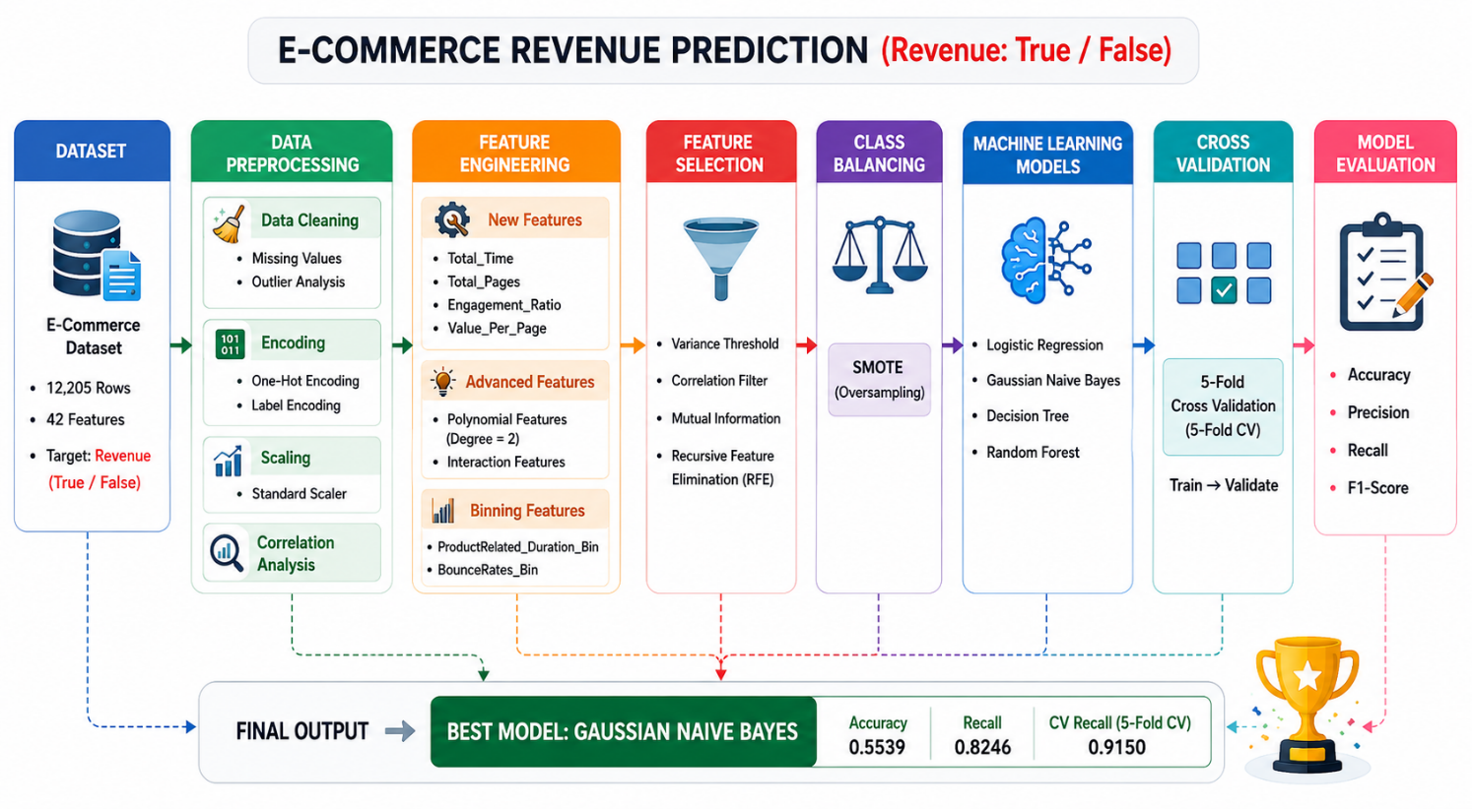
Pipeline of the Project

Slide 9
Feature Selection
Techniques Used
Variance Threshold
Correlation Filter
Recursive Feature Elimination (RFE)
Benefits
Removed irrelevant features
Reduced dimensionality
Improved model efficiency

Slide 10
Machine Learning Models
Models Applied
Logistic Regression
Gaussian Naive Bayes
Decision Tree
Random Forest
Validation Technique
5-Fold Cross Validation

Slide 11
Results
Model Performance Results
Model | Accuracy | Precision | Recall | F1-Score
Logistic Regression | 0.6313 | 0.6313 | 0.6313 | 0.6313
Gaussian Naive Bayes | 0.5539 | 0.5539 | 0.5539 | 0.5539
Decision Tree | 0.7206 | 0.7206 | 0.7206 | 0.7206
Random Forest | 0.7522 | 0.7522 | 0.7522 | 0.7522
Cross Validation Results
Model | Mean Recall
Logistic Regression | 0.7537
Decision Tree | 0.7974
Random Forest | 0.8917
Gaussian Naive Bayes | 0.9150

Slide 12
Critical Analysis
Gaussian NB Performed Best
Highest Recall
Highest Cross Validation Recall
Better identification of revenue-generating customers

Slide 13


